Slide 2
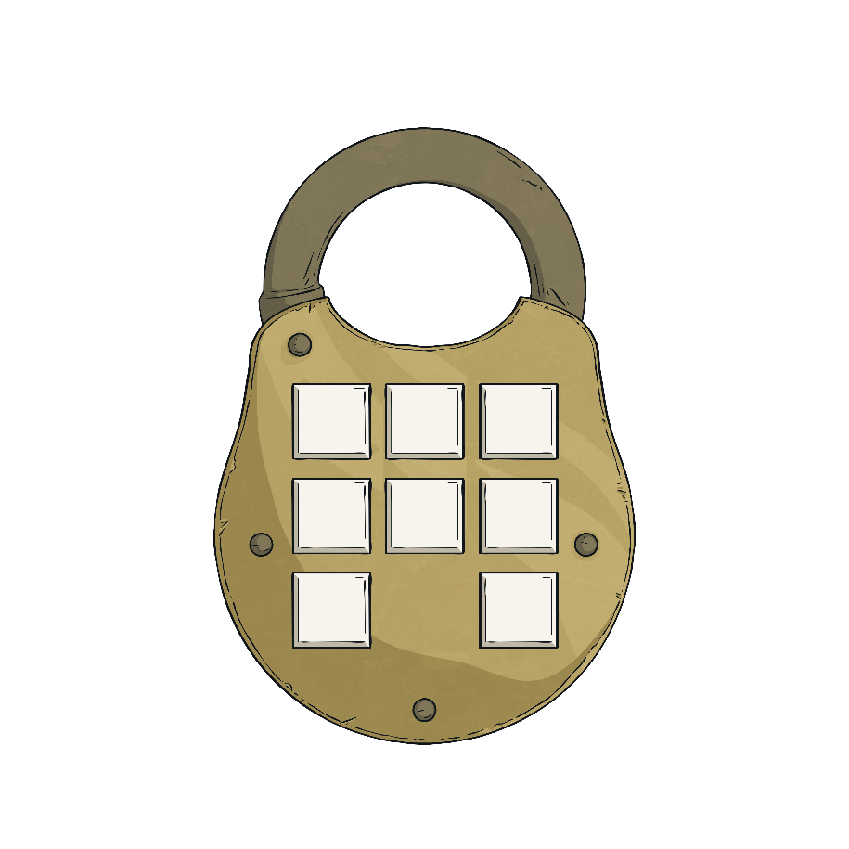
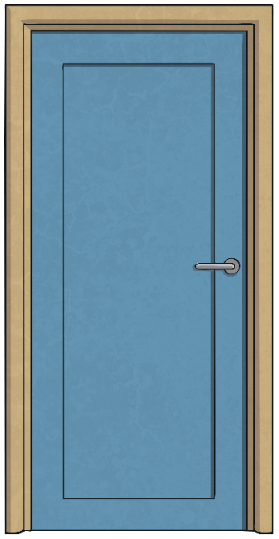
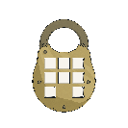
Lost in the Library
The clues could be anywhere, so you need to keep your eyes peeled and your mind sharp!
You are having a wonderful time reading and exploring books in the library. You found some really interesting books.
As the time to leave approaches, you realise all the librarians have left the library. You try the door and it is locked!
Luckily, an adult in your group has a plan of the library with a set of clues that will give the code to open the door. Solve the clues and puzzles to discover the passcode number needed to unlock the door to find your way out of the library.
?
?
?
?
?
?
?
?

Slide 3
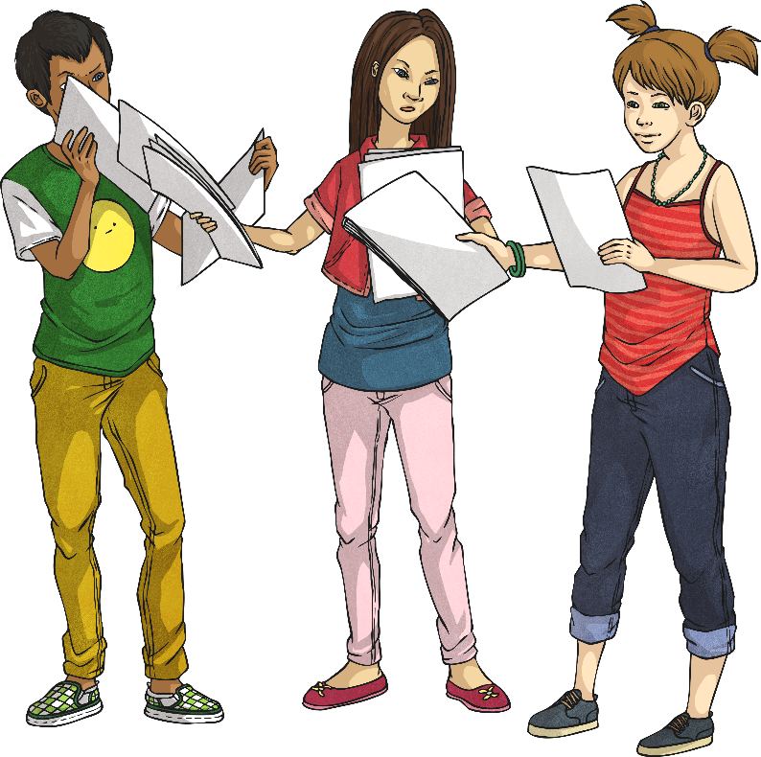
Lost in the Library
The Rules
You can work in small groups.
When you find a clue, work together to solve the puzzle.
Write your answer down on your answer sheet.
Once you have discovered the passcode number for the door, check it with your teacher to discover if you can escape the library!

Slide 4
Unlock the door
?
Click on a to check your answers.
When you have all the digits for the code, you can press the button to unlock the cupboard to get the special tokens!
Unlock
Digit 1
Digit 2
Digit 3
?
?
?
5
5
6
To unlock the door you need to solve more clues.
It won’t unlock until you have solved all the clues.
Almost there, one more before you can unlock the door.
You need to solve all the clues, keep solving.
You need to solve all of the clues to unlock the door.
Digit 4
Digit 5
Digit 6
Better hurry and solve the clues!
You need to solve more clues.
?
?
?
It’s still locked.
3
2
4
Digit 7
Digit 8
Unlock
Unlock
Unlock
Unlock
Unlock
Unlock
Unlock
Unlock
?
Unlock
?
5
4

Slide 5
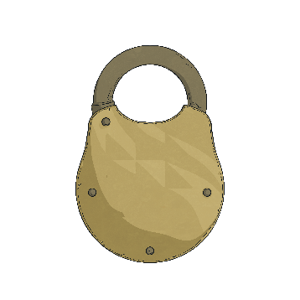
Clue 1
A book on multiplication tables provides the first clue. A page in the book contains tables triangles. Check that in each triangle, two of the numbers multiply to make the third.
21
29
29
32
24
44
24
3
3
3
4
4
4
7
9
4
9
8
5
11
5
18
18
24
38
38
64
108
108
8
8
8
8
8
8
8
2
8
2
3
6
6
8
12
12
The number of incorrect tables gives the first clue.
Reveal answer
5
The first digit of the code is

Slide 6
Clue 2
In a dictionary, a set of words are listed. Decide if each word would use the determiner ‘a’ or ‘an’.
book
author original paperback story
editor journal article index
editor
author
original
article
index
The number of words using the determiner ‘an’ gives the second clue.
Reveal answer
5
The second digit of the code is

Slide 7
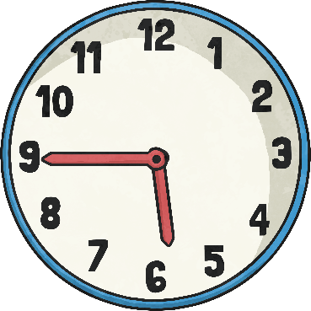
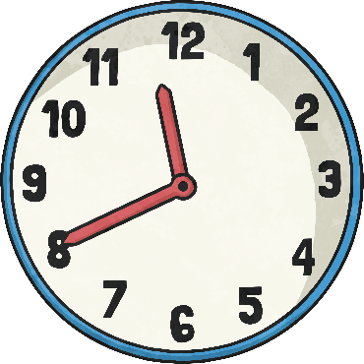
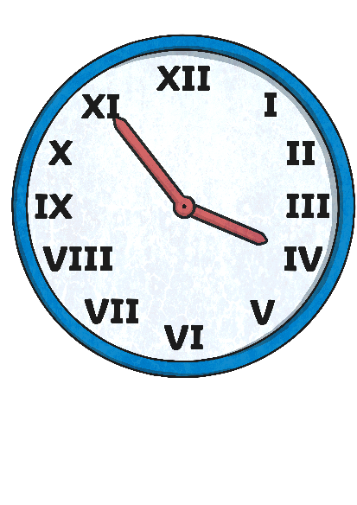
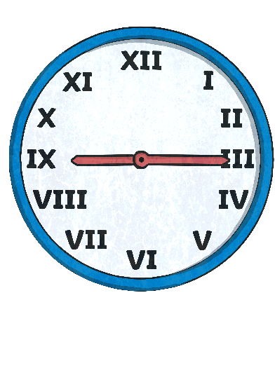
Clue 3
The library has a number of clocks on the wall showing the time in different cities around the world. All the times are between 9a.m. (before midday) and 6p.m. (after midday).
Are all the times after midday? Read each clock in 24-hour time.
Add the digits of each 24 hour time. The smallest total gives the third clue.
1140 (6)
1430 (8), 1745 (17), 1140 (6),
1555 (16), 0915 (15)
Reveal answer
6
The third digit of the code is

Slide 8
Clue 4
take able behave own appear inform well cover
helpful
count
infect
do
lucky
hurt pleasure hearten
A grammar book provides the fourth clue.
Match the prefixes dis-, mis- or un- to the following words. Some words can use two of these prefixes.
mis
un
dis
unable
mis
discount
mis
dis
dis
un
dis
un
mis
un
un
dis
dis
uncover
dis
The number of words using two of the prefixes un-, dis- or mis- gives the fourth clue.
Reveal answer
3
The fourth digit of the code is

Slide 9
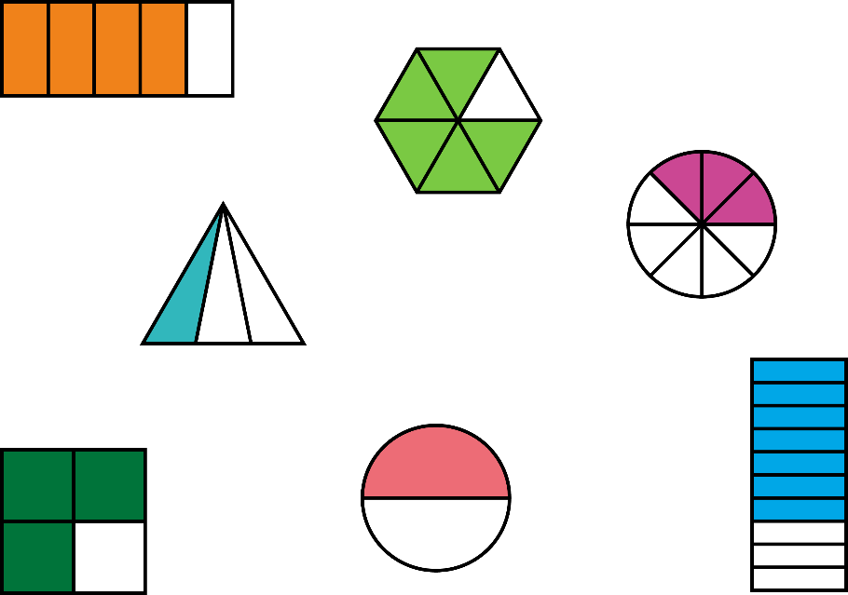
Clue 5
Clue number 5 is found on a poster in the library, which shows a set of fractions and pictorial representations of fractions.
1
_ 3
7
_ 10
1
_ 2
4
_ 5
2
2
3
_ 5
_ 5
_ 8
Match the fractions and representation. Find the fraction with no representation.
5
_ 6
3
_ 4
The numerator in the fraction with no equivalent representations gives the fifth clue.
Reveal answer
2
The fifth digit of the code is

Slide 10
Clue 6
The children looked carefully at all of the books because they needed to find all the clues quickly. There were some books that were out of reach, although they looked so dusty it was unlikely they had any clues. One clue was found in a book on fractions found by some girls. Another was on a poster,
hidden behind a screen until some boys moved it. Eventually, all the clues were found so they could open the door. Gratefully, all the children made their way out of the library to safety.
until
The sixth clue is in an adventure story. How many conjunctions are used­­?
because
so
although
The number of conjunctions used is the sixth clue.
Reveal answer
4
The sixth digit of the code is

Slide 11
Clue 7
There are 60 seconds in a minute.
13:30 is in the morning.
There are 30 days in April.
There are 12 hours between noon and midnight.
There are 100 seconds in 2 minutes.
A leap year has 366 days.
February always has 28 days.
5.30pm is in the afternoon.
There are 60 seconds in a minute.
The seventh clue appears on a computer screen, which has some sentences about time.
There are 30 days in April.
There are 12 hours between noon and midnight.
The number of correct sentences gives the seventh clue.
A leap year has 366 days.
5.30pm is in the afternoon.
Reveal answer
5
The seventh digit of the code is

Slide 12
Clue 8
“Can you help me?” asked one of the girls.
Clue number 8 is found in a notebook which has a set of sentences with speech.
“Can you help me?” asked one of the girls.
One boy said to another, there’s a clue on the poster.
Looking at the open book, she asked, “Do you understand this clue?”
“I’m getting hungry,” he whispered to his friend.
“This clue is easy, he said.”
A group of children looked at the screen, and one asked, “What does that mean”?
“I’ve got it!” she exclaimed.
The number of sentences with correctly punctuated speech gives the final clue.
Looking at the open book, she asked, “Do you understand this clue?”
“I’m getting hungry,” he whispered to his friend.
“I’ve got it!” she exclaimed.
Reveal answer
4
The eighth digit of the code is

Slide 13
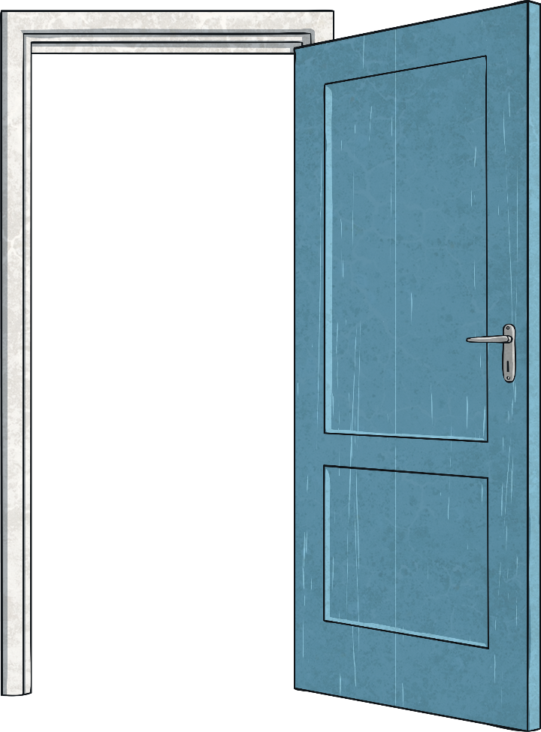
You escaped the Library!

