Slide 2
Why Do We Use Cameras?
Do you have a camera?
What does your camera look like?
When do you use your camera?
Why do we take photographs?

Slide 3
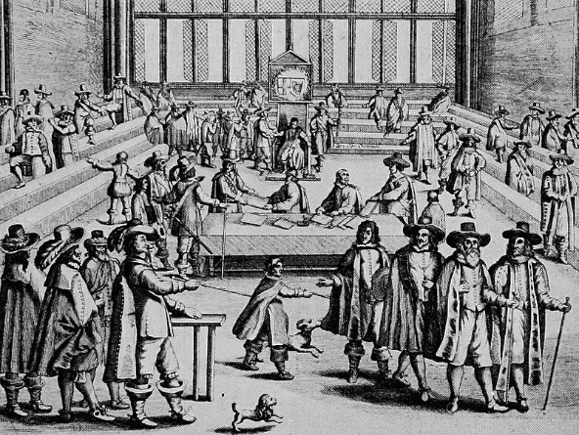
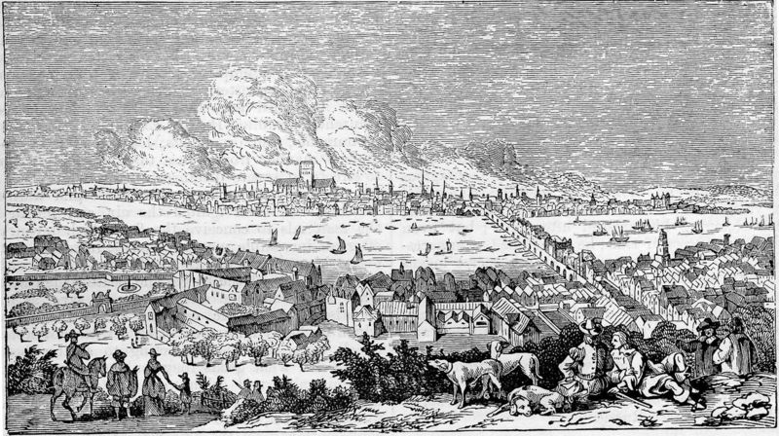
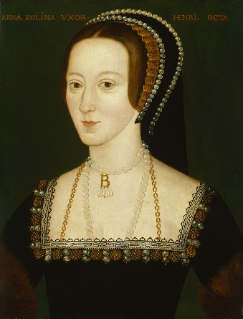
Before Cameras
How did people record important events before photographs?
How do we know what people looked like before photographs?
Before photography, images were drawn, painted or etched. These were not as detailed as photographs, took time to produce and could be influenced by the artists style or bias.

Slide 4
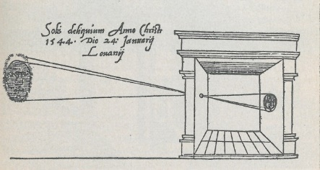
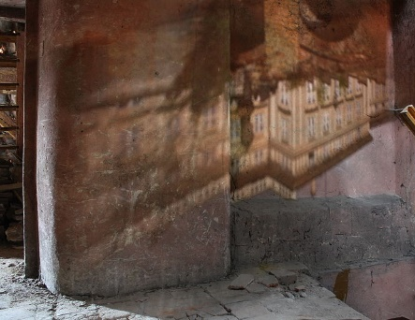
Camera Obscura
Before the first cameras, experiments were performed using light trickery to form camera obscura images.
‘Camera obscura’ means ‘dark room’ in Latin.
If something is lit by the sun and a small hole is drilled in the wall of a dark room in a building facing this, then all objects illuminated by the sun will send their images through the hole and will appear upside down on the wall facing the hole.
This technique was used for a variety of purposes: to observe planets, moons and stars, to safely watch eclipses, as a drawing aid and entertainment.
“Camera obscura Prague” by Gampe is licensed under CC BY 3.0
Later, the hole was replaced by a lens and larger images could be projected onto walls using this method.

Slide 5
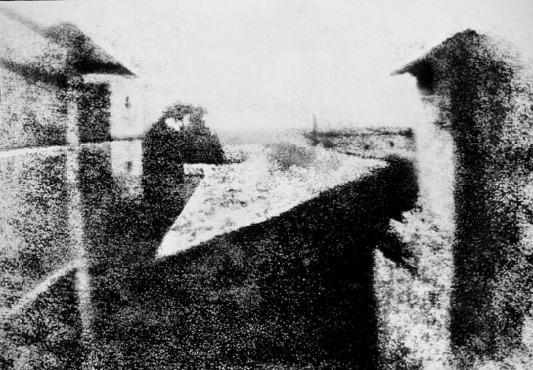
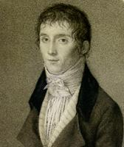
The First Photographic Camera
Before photographic cameras, it was known that some materials, such as silver salts, darkened when exposed to sunlight.
Many people experimented with this idea, using different chemicals and exposing them to light to make a temporary picture.
The first permanent photograph was made in 1825 by Joseph Nicéphore Niépce who took a photo of the view outside his window (see right). To do this, he used a wooden box and a sheet of pewter coated in bitumen.
In order to capture the photograph, the pewter sheet had to be exposed to the sunlight for 8 hours.

Slide 6
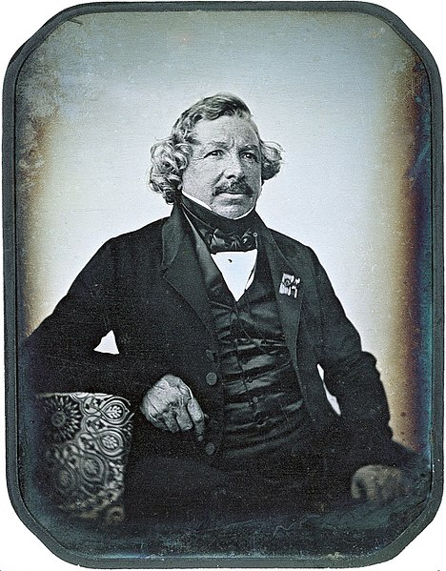
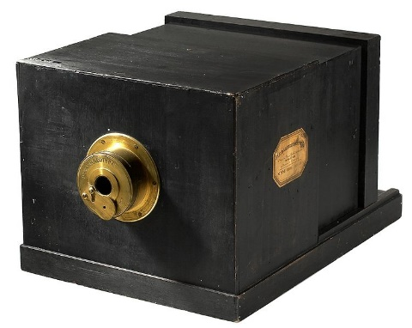
Daguerreotype Camera
After Niépce died, his partner Louis Daguerre kept experimenting with photography and in 1839, unveiled his daguerreotype camera.
This camera had a removable glass screen which could be used to adjust the focus.
The daguerreotype was the first publicly available photographic process and was the most commonly used for around 20 years.

Slide 7
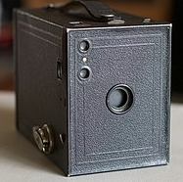
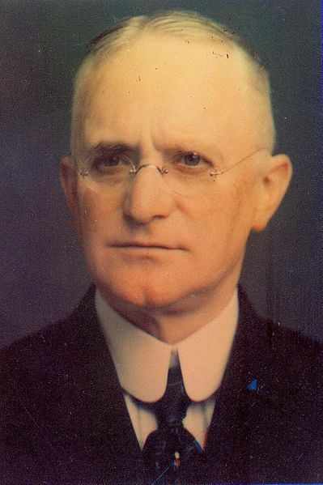
Photographic Film Cameras
The first celluloid film camera was created in 1888 by George Eastman. His camera, called the ‘Kodak’, was a simple box camera with a fixed focus lens. It came loaded with enough film to take 100 photographs, then had to be sent back to the factory to be reloaded.
In 1900, Eastman released the Brownie camera which also used film but could take more pictures and could be refilled using Kodak film rolls rather than being sent to the factory.
The Brownie proved incredibly popular due to simple controls and being cheap and continued selling well until the 1960s.

Slide 8
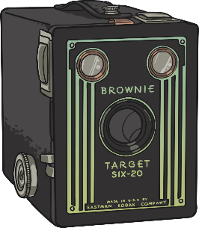
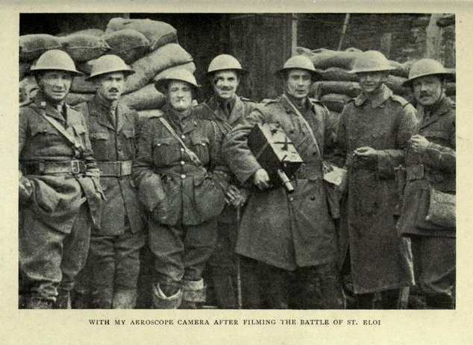
Early Movie Cameras
The development of photographic film meant that movie cameras were able to become a more widely available tool.
In 1911, the Aeroscope became the first successful hand-held movie camera and could be operated with both hands meaning it could be used in more difficult situations, such as while in the air.
In 1923, Eastman produced new 16mm film for producing motion pictures. It was widely used for home movies and for educational films.
First World War soldiers with an Aeroscope camera.

Slide 9
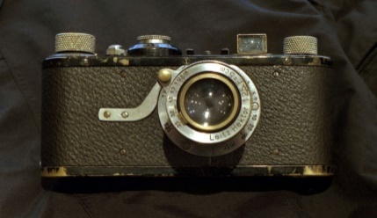
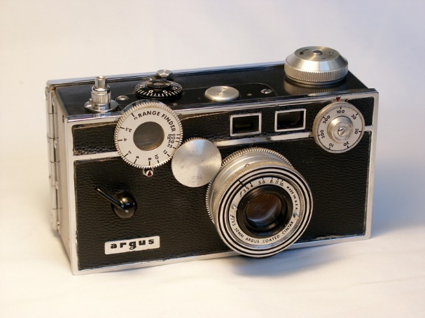
35mm Film
Between 1905 and 1913, manufacturers started to develop and use 35mm film for still photography. The first 35mm cameras became available to the public in 1913.
“Leica-I-1” by Rama is licensed under CC BY 2.0
Oskar Marnack experimented with using 35mm film to create a compact camera for public use. He created a prototype in 1913 but development was delayed due to the First World War. In 1923, he marketed the design and, as it proved popular, put it into production as the Leica I in 1925.
“Argus C3” by Camerfiend is licensed under CC BY 2.0
Many compact cameras that started to be developed at the time were still too expensive for many people. It wasn’t until the introduction of cheaper cameras years later, such as the Argus C3, that compact 35mm film cameras became popular.

Slide 10
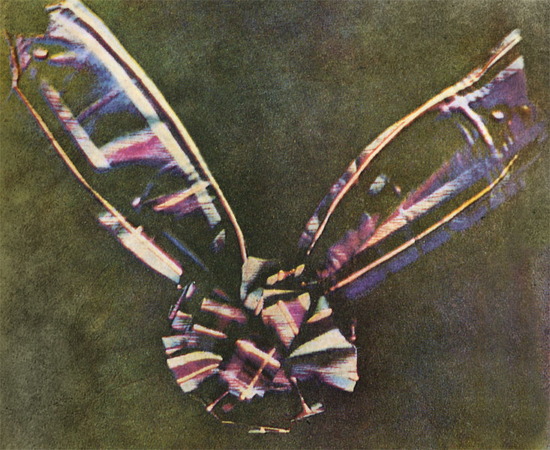
Colour Photography
The first durable colour photographs were made in the 1800s. However, the technique was extremely difficult and expensive.
With the development of 35mm film in the 1930s came the advancement of colour photographs. The film was able to capture red, green and blue colours in layers of film and, after using dyes to tint the image, was able to produce a colour photograph.
The first durable colour photograph – ‘Tartan Ribbon’, taken by James Clerk Maxwell, 1861.

Slide 11
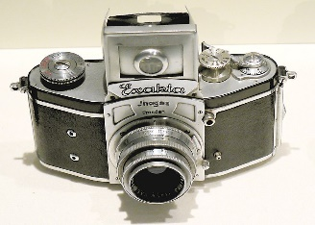
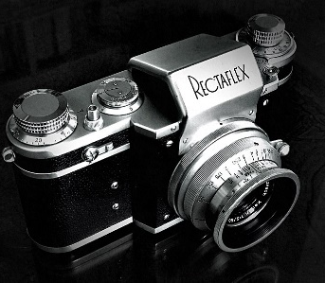
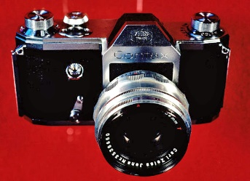
SLR Cameras
SLR (single-lens reflex) cameras started to be developed in the 1930s. The idea had been around for decades but they were too big and heavy to be of use to the public.
Exacta Camera, 1936
“Kine Exakta 1 1936 02” by Hans-Peter Scholzis licensed under CC BY 3.0
35mm SLR cameras were the first to have viewfinders and became incredibly popular with the public.
Early models include the Exacta, the Rectaflex and the Contax S.
Rectaflex Camera, 1948
“Rectaflex” by Antonio Calossi licensed under CC BY 2.0
SLR cameras have continued to be popular for decades. Despite the advances in digital photography, many photographers prefer to use SLR cameras today.
Contax S Camera, 1949

Slide 12
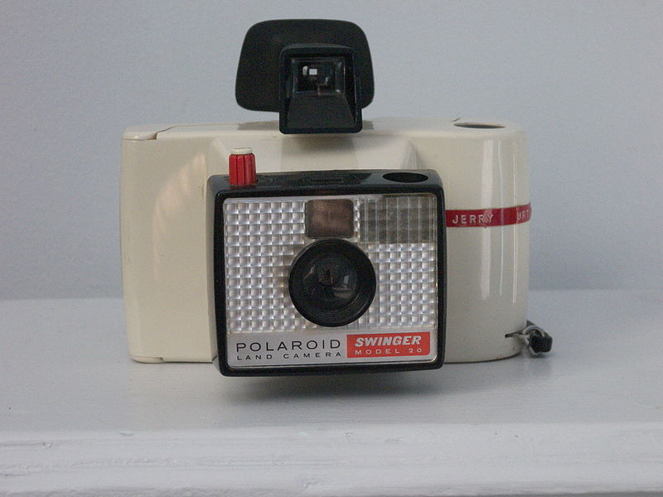
Instant Cameras
After the Second World War, a whole new type of camera started to appear.
The Polaroid Model 95, an instant-picture camera, which produced finished printed photographs in under a minute using a special chemical process, was released in 1948.
“Polaoid Swinger Model 20” by Terry Monahon licensed under CC BY 2.0
In 1965, the Polaroid Model 20 Swinger was released and was a huge success. It remains one of the most iconic and best-selling cameras of all time.

Slide 13
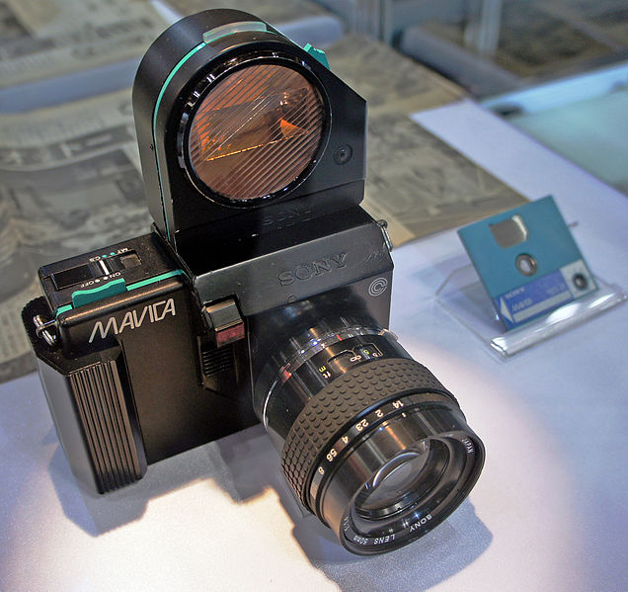
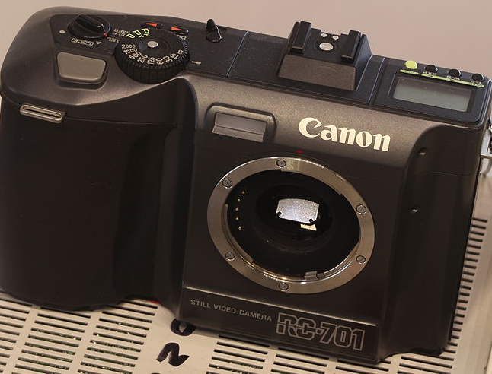
Early Electronic Cameras
The first electronic camera concepts came from the idea of spy satellites no longer needing film as replacing it while in orbit was a difficult task.
The first handheld electronic camera was made in 1981. The Sony Mavica recorded images onto a disk inside it.
However, it wasn’t until 1986 that electronic cameras went on sale to the public. Even then, they were expensive to buy and the quality was poorer than film.
“Canon RC-701 img 0829” by Rama licensed under CC BY 2.0

Slide 14
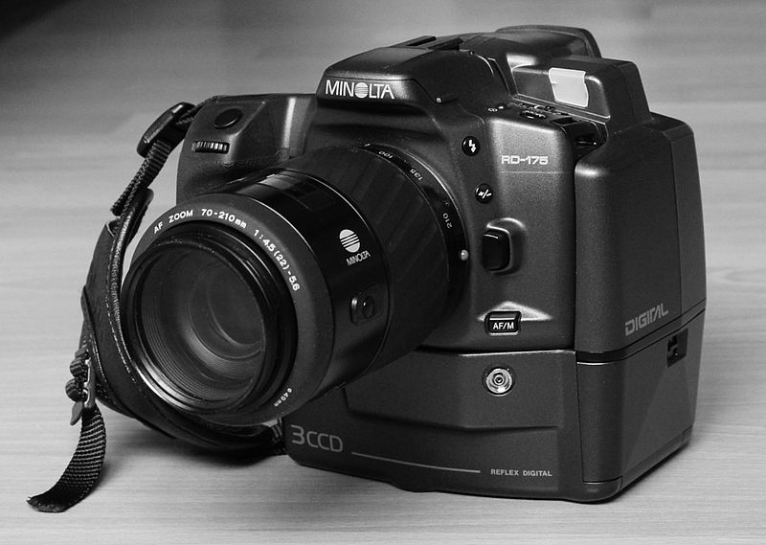
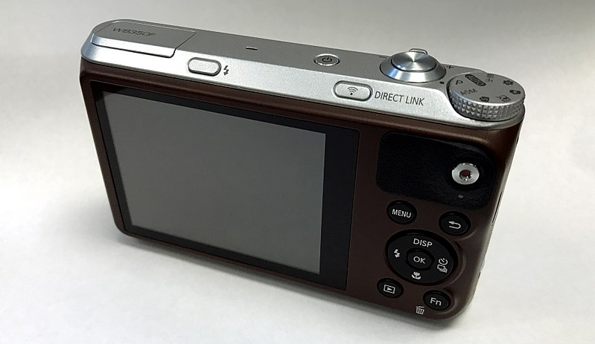
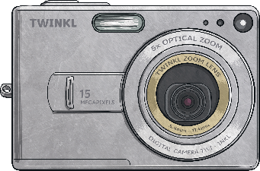
Digital Cameras
In the late 1980s, technology meant that true digital cameras were available and began to be sold to the public. Cameras were becoming more common, being made by more companies around the world and were therefore becoming cheaper.
As major technological advances were made, digital cameras became smaller, lighter, able to take more detailed photographs and able to hold more photos.
“Minolta RD-175 Digital SLR” by Jamo Spingal licensed under CC BY 2.0
Today, most people have access to a digital camera, either through an actual handheld camera, a smartphone or a tablet.
“Samsung WB350F back” by Cody Logan licensed under CC BY 2.0

Slide 15
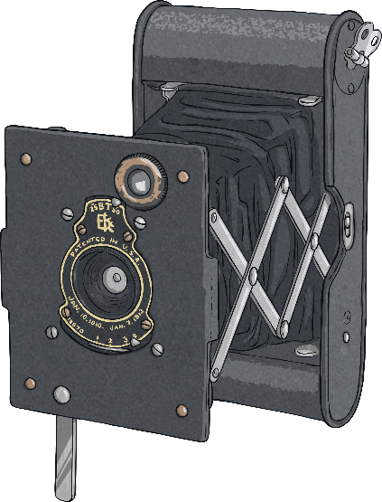
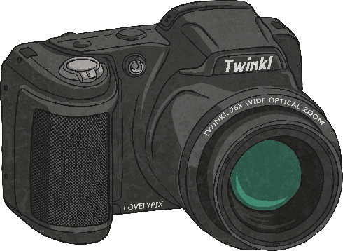
The Future
Camera technology has rapidly advanced in the last few decades.
What do you think the future holds for cameras?
What will be the next major breakthrough in photography?

