Slide 1
LIFE/work balance
We have started a #LIFEworkbalance campaign and we need your help to complete our LIFE/work balance survey.
We hope to publish the results soon, so please give 15 minutes of your time to help us get a true picture of school life.
Want to be a part of this campaign? Take the survey on our website and share it with your colleagues!
© Classroom Secrets Limited 2019

Slide 2
Year 1 – Summer Block 4 – Place Value – Comparing Numbers 2
About This Resource:
This PowerPoint has been designed to support your teaching of this small step. It includes a starter activity and an example of each question from the Varied Fluency and Reasoning and Problem Solving resources also provided in this pack. You can choose to work through all examples provided or a selection of them depending on the needs of your class.
National Curriculum Objectives:
Mathematics Year 1: (1N4) Identify and represent numbers using objects and pictorial representations including the number line, and use the language of: equal to, more than, less than (fewer), most, least
More Year 1 Place Value resources.
Did you like this resource? Don’t forget to review it on our website.
© Classroom Secrets Limited 2019

Slide 3
Year 1 – Summer Block 4 – Place Value
Step 4: Comparing
Numbers 2
© Classroom Secrets Limited 2019

Slide 4
Introduction
The green square equals 6. The blue circle equals 4.
What could the orange triangle equal to make the statement true?
6
>
4
© Classroom Secrets Limited 2019

Slide 5
Introduction
The green square equals 6. The blue circle equals 4.
What could the orange triangle equal to make the statement true?
The orange triangle could equal 5, 4, 3, 2 or 1.
6
>
4
© Classroom Secrets Limited 2019

Slide 6
Varied Fluency 1
Circle the biggest number.
67
87
76
© Classroom Secrets Limited 2019

Slide 7
Varied Fluency 1
Circle the biggest number.
67
87
76
© Classroom Secrets Limited 2019

Slide 8
Varied Fluency 2
Compare the numbers using <, > and =.
59 |  | 53
© Classroom Secrets Limited 2019

Slide 9
Varied Fluency 2
Compare the numbers using <, > and =.
59 | > | 53
© Classroom Secrets Limited 2019

Slide 10
Varied Fluency 3
Choose the number to make the statement correct.
69
44
78
 | < | 68
© Classroom Secrets Limited 2019

Slide 11
Varied Fluency 3
Choose the number to make the statement correct.
69
44
78
44 | < | 68
© Classroom Secrets Limited 2019

Slide 12
Varied Fluency 4
Put the information from the
stem sentence into the correct place.
22 is more than 19.
© Classroom Secrets Limited 2019

Slide 13
Varied Fluency 4
Put the information from the
stem sentence into the correct place.
22 is more than 19.
22 | > | 19
© Classroom Secrets Limited 2019

Slide 14
Problem Solving 1
Two numbers are circled. Put one number into each box to make the statement correct.
1 | 2 | 3 | 4 | 5 | 6 | 7 | 8 | 9 | 10
11 | 12 | 13 | 14 | 15 | 16 | 17 | 18 | 19 | 20
21 | 22 | 23 | 24 | 25 | 26 | 27 | 28 | 29 | 30
 | >
© Classroom Secrets Limited 2019

Slide 15
Problem Solving 1
Two numbers are circled. Put one number into each box to make the statement correct.
1 | 2 | 3 | 4 | 5 | 6 | 7 | 8 | 9 | 10
11 | 12 | 13 | 14 | 15 | 16 | 17 | 18 | 19 | 20
21 | 22 | 23 | 24 | 25 | 26 | 27 | 28 | 29 | 30
26 | > | 19
© Classroom Secrets Limited 2019

Slide 16
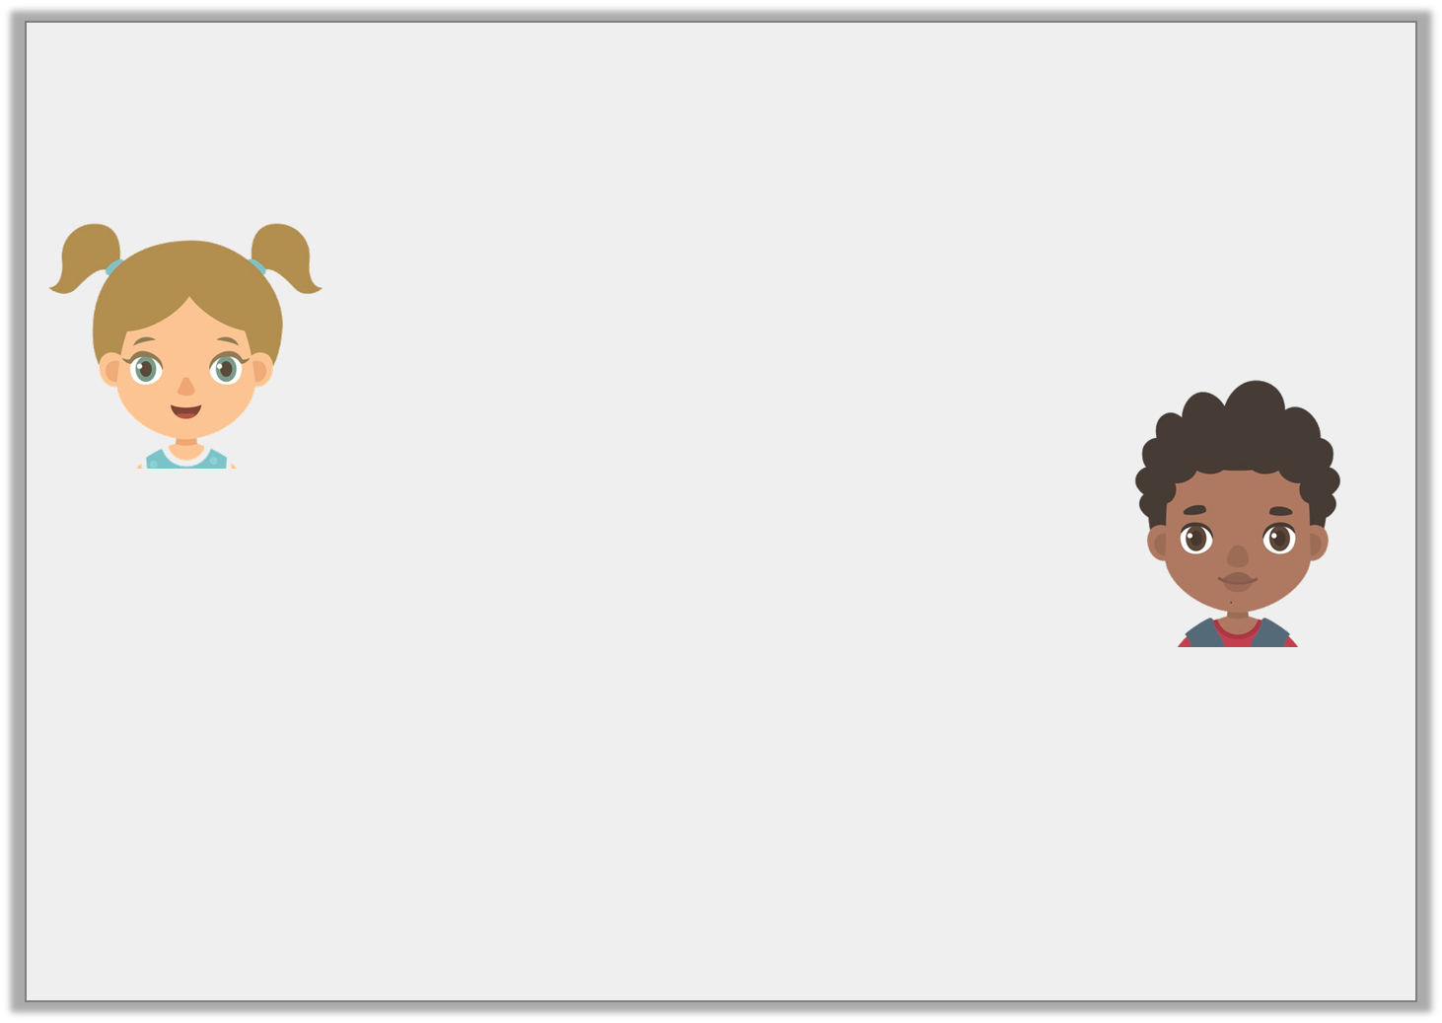
Reasoning 1
Annie and Carl both do a spelling test.
Who got the highest score?
Explain why.
I got 23 questions correct.
I got 32 questions correct.
Annie
Carl
© Classroom Secrets Limited 2019

Slide 17
Reasoning 1
Annie and Carl both do a spelling test.
Who got the highest score?
Explain why.
Carl got the highest score because...
I got 23 questions correct.
I got 32 questions correct.
Annie
Carl
© Classroom Secrets Limited 2019

Slide 18
Reasoning 1
Annie and Carl both do a spelling test.
Who got the highest score?
Explain why.
Carl got the highest score because 3 tens is more than 2 tens.
I got 23 questions correct.
I got 32 questions correct.
Annie
Carl
© Classroom Secrets Limited 2019

Slide 19
Problem Solving 2
Use the digit cards to make the statement correct.
Find 4 different ways.
4
1
2
5
 |  | >
 |  | >
 |  | >
 |  | >
© Classroom Secrets Limited 2019

Slide 20
Problem Solving 2
Use the digit cards to make the statement correct.
Find 4 different ways.
4
1
2
5
Examples:
5 | 1 | > | 4 | 2
5 | 4 | > | 1 | 2
4 | 5 | > | 2 | 1
4 | 1 | > | 2 | 5
© Classroom Secrets Limited 2019

