Slide 1
English
Each week will have a set structure
Monday – Big Write
Tues/Weds/Thurs – Phonics and sentence work
Friday – Editing Monday’s Big Write
Use the Big Write slides to give you ideas for your story. If you have already written a story for the chosen picture just select another one! Remember adults shouldn't’t help you with your Big Write when you first write it. Don’t forget to dot your page first!

Slide 2
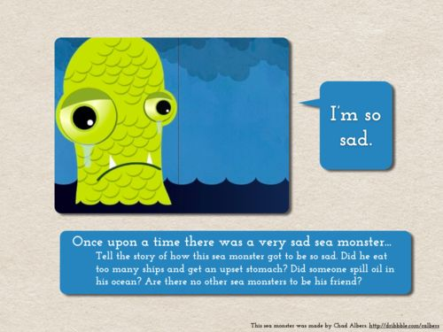
Monday 22nd June – Big Write
Things to Remember:
capital letters
full stops
commas
? ' ! " "
adjectives
adverbs
conjunctions
tricky words
REMEMBER TO CHECK: spellings, punctuation, Does it make sense?

Slide 3
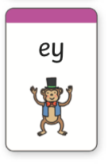
Tuesday 23rd June
2 minute time challenge - How many words can you think of using the ey sound
Next use these words and write a sentence for each one. Write at least 6 sentences
Now write a short story, it could be a silly story, using all of your ey words!

Slide 4
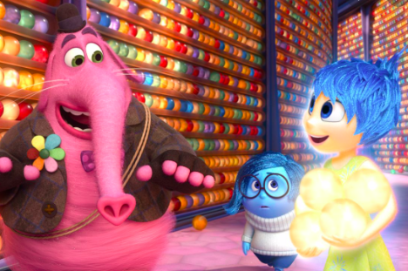
Wednesday 24th June
2 minute time challenge – see how many adjectives you can think of. Remember an adjective is a describing word
Now use those words in sentences. Think of some exciting nouns to describe. They could be characters or places.
Use your sentences to write a short character description. Choose someone exciting to describe!

Slide 5
Thursday 25th June
2 minute time challenge – using the prefix un. See how many words you can think of that start with un e.g. unhappy
Use your words in sentences. See if you can write 10 sentences.
If you can’t think of 10 different un words you can use a word again and write a different sentence about it
Remember: A prefix is a set of letters we
add onto the start of a word to change its meaning

Slide 6
Friday 26th June – Big Write Editing
Turn back to Monday’s Big Write about the sad sea monster and edit your story.

Slide 7
Monday 29nd June – Big Write
Things to Remember:
capital letters
full stops
commas
? ' ! " "
adjectives
adverbs
conjunctions
tricky words
REMEMBER TO CHECK: spellings, punctuation, Does it make sense?

Slide 8
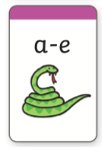
Tuesday 30th June
2 minute time challenge - How many words can you think of using the a-e sound
Next use these words and write a sentence for each one. Write at least 6 sentences
Now write a short story, it could be a silly story, using all of your a-e words!

Slide 9
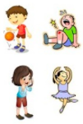
Wednesday 1st July
2 minute time challenge – see how many verbs you can think of. Remember an verb is a doing word.
Now use those words in sentences. Think of some exciting places where the verbs could be done.
Write a short silly story about you doing all the verbs you wrote down!

Slide 10
Thursday 2nd July
2 minute time challenge – using the suffix ful. See how many words you can think of that end with ful e.g. hurtful
Use your words in sentences. See if you can write 10 sentences.
If you can’t think of 10 different ful words you can use a word again and write a different sentence about it
Remember: A suffix is a set of letters we
add onto the end of a word to change its meaning

Slide 11
Friday 3rd July – Big Write Editing
Turn back to Monday’s Big Write where you designed the perfect playground. It’s time to edit!

Slide 12
Monday 6th July – Big Write
Things to Remember:
capital letters
full stops
commas
? ' ! " "
adjectives
adverbs
conjunctions
tricky words
REMEMBER TO CHECK: spellings, punctuation, Does it make sense?
You get given a set of magical chalk and go on an adventure. Anything you draw comes to life. What happens with your chalk?

Slide 13
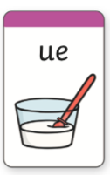
Tuesday 7th July
2 minute time challenge - How many words can you think of using the ue sound
Next use these words and write a sentence for each one. Write at least 6 sentences
Now write a short story, it could be a silly story, using all of your ue words!

Slide 14
Wednesday 1st July
2 minute time challenge – see how many adverbs you can think of. Remember an adverb describes the verb e.g. loudly
Now use those words in sentences. Think of some exciting things to do.
Write a short paragraph using all of your adverbs. See if you can use some of them twice!

Slide 15
Thursday 2nd July
2 minute time challenge – using the suffix ness. See how many words you can think of that end with ness e.g. sadness
Use your words in sentences. See if you can write 10 sentences.
If you can’t think of 10 different ness words you can use a word again and write a different sentence about it
Remember: A suffix is a set of letters we
add onto the end of a word to change its meaning

Slide 16
Friday 10th July– Big Write Editing
Turn back to Monday’s Big Write about your magical chalk adventure and edit your story.

Slide 17
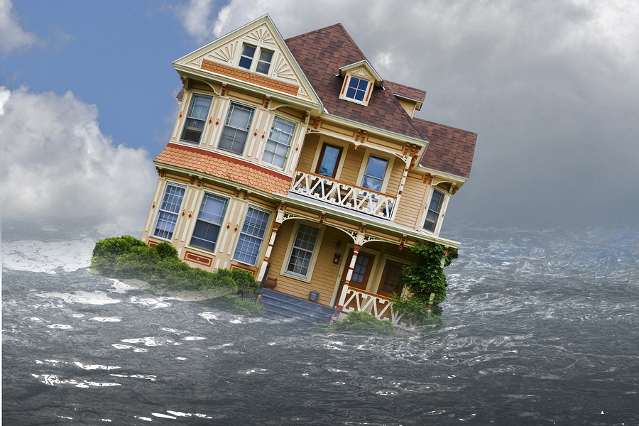
Monday 13th July – Big Write
“The town!” It’s starting to float away!” shouted Millie as she watched the house sail out to see. “What are we going to do?” I asked worriedly.
Things to Remember:
capital letters
full stops
commas
? ' ! " "
adjectives
adverbs
conjunctions
tricky words
REMEMBER TO CHECK: spellings, punctuation, Does it make sense?

Slide 18
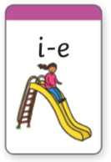
Tuesday 14th July
2 minute time challenge - How many words can you think of using the i-e sound
Next use these words and write a sentence for each one. Write at least 6 sentences
Now write a short story, it could be a silly story, using all of your i-e words!

Slide 19
Wednesday 15th July
2 minute time challenge – see how many conjunctions you can think of. Remember a conjunction joins twos sentences together.
Now use your conjunctions in sentences. Think of some exciting and unusual ideas.
Use your conjunctions to write a very short story. Try and give it a beginning, middle and an end. You can use a conjunction more than once!

Slide 20
Thursday 16th July
2 minute time challenge – using the prefix dis. See how many words you can think of that start with dis e.g. disagree
Use your words in sentences. See if you can write 10 sentences.
If you can’t think of 10 different dis words you can use a word again and write a different sentence about it
Remember: A prefix is a set of letters we
add onto the start of a word to change its meaning

Slide 21
Friday 17th July – Big Write Editing
Turn back to Monday’s Big Write about the town that sailed away and edit your story.

