Slide 1
LIFE/work balance
We have started a #LIFEworkbalance campaign and we need your help to complete our LIFE/work balance survey.
We hope to publish the results soon, so please give 15 minutes of your time to help us get a true picture of school life.
Want to be a part of this campaign? Take the survey on our website and share it with your colleagues!
© Classroom Secrets Limited 2019

Slide 2
Year 1 – Summer Block 2 – Fractions – Halving Shapes or Objects
About This Resource:
This PowerPoint has been designed to support your teaching of this small step. It includes a starter activity and an example of each question from the Varied Fluency and Reasoning and Problem Solving resources also provided in this pack. You can choose to work through all examples provided or a selection of them depending on the needs of your class.
National Curriculum Objectives:
Mathematics Year 1: (1F1a) Recognise, find and name a half as one of two equal parts of an object, shape or quantity
Mathematics Year 1: (1M1): Compare, describe and solve practical problems for lengths and heights [for example, long/short, longer/shorter, tall/short, double/half]
More Year 1 Fractions resources.
Did you like this resource? Don’t forget to review it on our website.
© Classroom Secrets Limited 2019

Slide 3
Year 1 – Summer Block 2 – Fractions
Step 1: Halving Shapes
or Objects
© Classroom Secrets Limited 2019

Slide 4
Introduction
Match each shape with its other half.
© Classroom Secrets Limited 2019

Slide 5
Introduction
Match each shape with its other half.
© Classroom Secrets Limited 2019

Slide 6
Varied Fluency 1
Draw a line to cut each item in half.
Tick the item that has 2 ways of halving.
© Classroom Secrets Limited 2019

Slide 7
Varied Fluency 1
Draw a line to cut each item in half.
Various possible answers, for example:
Tick the item that has 2 ways of halving.
✓
© Classroom Secrets Limited 2019

Slide 8
Varied Fluency 2
Draw lines to connect the two halves making one whole.
© Classroom Secrets Limited 2019

Slide 9
Varied Fluency 2
Draw lines to connect the two halves making one whole.
© Classroom Secrets Limited 2019

Slide 10
Varied Fluency 3
Circle any shapes which are cut in half.
A
B
C
© Classroom Secrets Limited 2019

Slide 11
Varied Fluency 3
Circle any shapes which are cut in half.
A
B
C
© Classroom Secrets Limited 2019

Slide 12
Varied Fluency 4
Colour half of each shape.
© Classroom Secrets Limited 2019

Slide 13
Varied Fluency 4
Colour half of each shape.
© Classroom Secrets Limited 2019

Slide 14
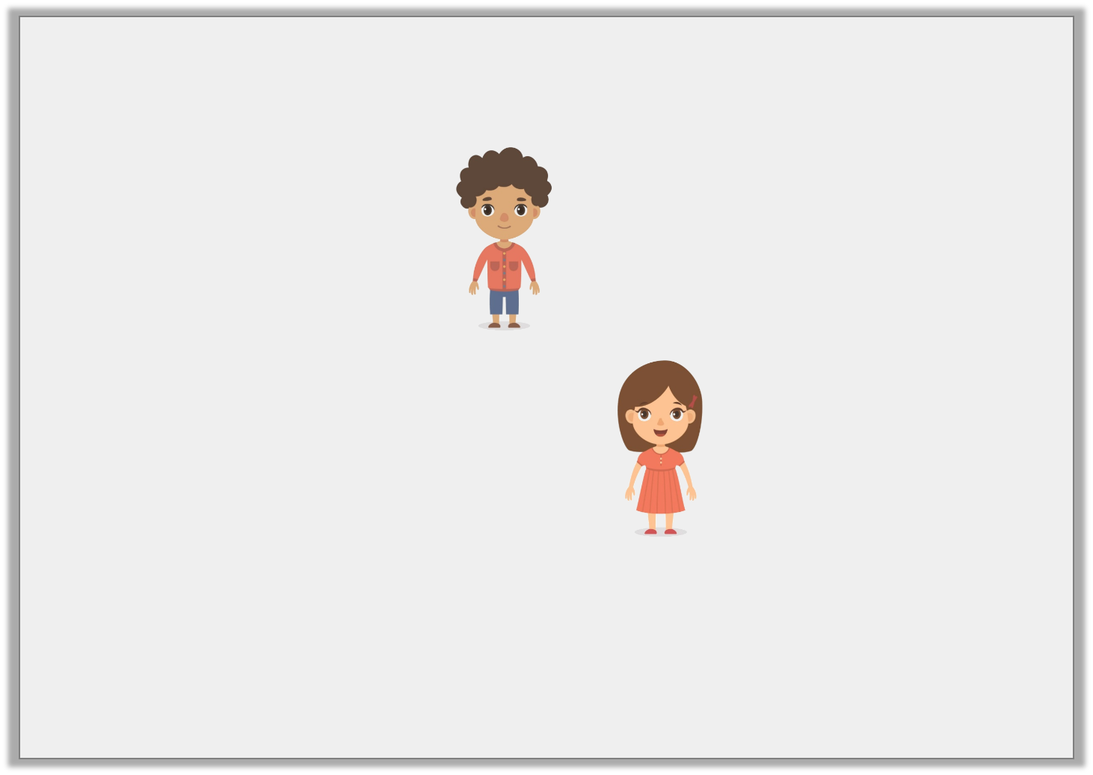
Reasoning 1
Are the children correct?
Explain your answer.
There is only 1
way to cut my shape in half.
Matt
I have cut my shape in half.
Sandi
© Classroom Secrets Limited 2019

Slide 15
Reasoning 1
Are the children correct?
Explain your answer.
Matt is not correct because…
Sandi is not correct because…
There is only 1
way to cut my shape in half.
Matt
I have cut my shape in half.
Sandi
© Classroom Secrets Limited 2019

Slide 16
Reasoning 1
Are the children correct?
Explain your answer.
Matt is not correct because it can be split vertically, horizontally and diagonally.
Sandi is not correct because it can only be split horizontally.
There is only 1
way to cut my shape in half.
Matt
I have cut my shape in half.
Sandi
© Classroom Secrets Limited 2019

Slide 17
Problem Solving 1
Colour the hexagons to match their labels.
less than half
exactly
half
more than half
© Classroom Secrets Limited 2019

Slide 18
Problem Solving 1
Colour the hexagons to match their labels.
Various possible answers, for example:
less than half
exactly
half
more than half
© Classroom Secrets Limited 2019

Slide 19
Reasoning 2
Circle the odd one out.
Explain your reasoning.
A
B
C
© Classroom Secrets Limited 2019

Slide 20
Reasoning 2
Circle the odd one out.
Explain your reasoning.
C is the odd one out because…
A
B
C
© Classroom Secrets Limited 2019

Slide 21
Reasoning 2
Circle the odd one out.
Explain your reasoning.
C is the odd one out because it is split into 2 equal parts.
A
B
C
© Classroom Secrets Limited 2019

