Slide 2
Aim
To revise and make further investigations of the Year 5 and Year 6 spelling patterns/rules from the 2014 national curriculum.
Success Criteria
I can recall spelling patterns and the methods I can use to determine
which to use.
I can investigate spelling patterns independently.

Slide 3
Endings which sound like ‘shuss’ and are spelled -cious or -tious
Which endings need to be applied to turn the following root words in to adjectives?
ambition
ambitious
vice
vicious
infection
infectious
caution
cautious
malice
malicious
superstition
superstitious
nutrition
nutritious
Which is most common? Find 10 more words spelt with –cious or –tious and see what you think.

Slide 4
Endings which sound like ‘shul’ and are spelt -cial or -tial
Which of the following are spelt correctly?
parcial
partial
artifitial
artificial
essential
special
presidential
benefitial
beneficial
substancial
substantial
Can you think of any words with these spelling patterns in the middle?

Slide 5
Words ending in -ant, -ance/-ancy, -ent, -ence/-ency
Which of the following are spelt correctly?
excellance
excellence
president
evidance
evidence
resident
expectent
expectant
restaurent
restaurant
parliamant
parliament
Can you think of a word that doesn’t follow the rule given in the clue?

Slide 6
Words ending in -able
Which of the following are spelt correctly?
dependible
dependable
indestructable
reasonable
enjoyible
enjoyable
bearible
bearable
vegetible
vegetable
edible
What is the shortest word you can think of that uses one of these prefixes?

Slide 7
Words ending in –ible and -ibly
Will you use –ible or –ibly to finish these words off?
terr
-ible
-able
sens
-ibly
-ably
incred
-ible
-able
save
-ible
-able
watch
-ible
-able
Find some –ible and –able words – read them aloud to a partner. Can you predict the ending by following the clue?

Slide 8
Adding suffixes beginning with vowel letters to words ending in -fer
Which of these suffixes have been added correctly?
prefer
-prefering
-preferring
refer
-reference
-referrence
transfer
-transference
-transferrence
confer
-confered
-conferred
defer
-defering
-deferring
Use the double ‘r’ pattern to find a word with as many r’s in it as possible.

Slide 9
Use of the hyphen
Where would the hyphen need to be positioned in these words?
reenter
re-enter
coordination
co-ordination
cooperate
co-operate
coown
co-own
re-cover
recover
Experiment with words that have prefixes on a spell check. How many can you find that your spell check will not accept without hyphens?

Slide 10
Words with the ‘ee’ sound spelt ‘ei’ after ‘c’
Can you put the letters e and i into these words to make the spellings correct?
c
e
i
ling
rec
e
i
ve
bel
i
e
ve
dec
e
i
ve
caff
e
i
ne
How many words can you think of where there is just plain ‘i’ before ‘c’?

Slide 11
Words containing the letter string -ough
How many different sounds does –ough make in this word list?
bought
although
thought
tough
cough
though
through
thorough
ought
enough
brought
bough
How many other words can you think of which contain the letter string -ough?

Slide 12
Words with ‘silent’ letters
Add silent letters to these words to make correct spellings…
dout
doubt
iland
island
lam
lamb
solem
solemn
autum
autumn
niht
knight
What is the word you can find that has the largest number of silent letters?

Slide 13
Homophones – nouns ending in -ce and verbs ending in -se
Can you think of a sentence to put each of these words into?
Noun
Verb
advice
advise
device
devise
licence
license
practice
practise
prophecy
prophesy
Can you find any more sets of words that follow the –ce/-se pattern?

Slide 14
Homophones and other words that are often confused
How many of these words can you think of a homophone or near-homophone for?
isle
aisle
herd
heard
allowed
aloud
led
lead
father
farther
past
passed
guessed
guest
mourning
morning

Slide 15
Homophones and other words that are often confused
Match these confusable words to their correct definitions…
descent
The act of going down.
dissent
To disagree.
dessert
A barren place (noun). To leave a position of responsibility (verb).
desert
Pudding after a main course.
draught
First attempt at writing something.
draft
A current of air.

Slide 16
Homophones and other words that are often confused
Match these confusable words to their correct definitions…
stationery
Equipment used for writing and drawing.
stationary
Not moving.
principal
Basic belief.
principle
Most important person.
profit
Someone who tells the future.
prophet
Money made from an enterprise.

Slide 17
Aim
To revise and make further investigations of the Year 5 and Year 6 spelling patterns/rules from the 2014 national curriculum.
Success Criteria
I can recall spelling patterns and the methods I can use to determine
which to use.
I can investigate spelling patterns independently.

Slide 19
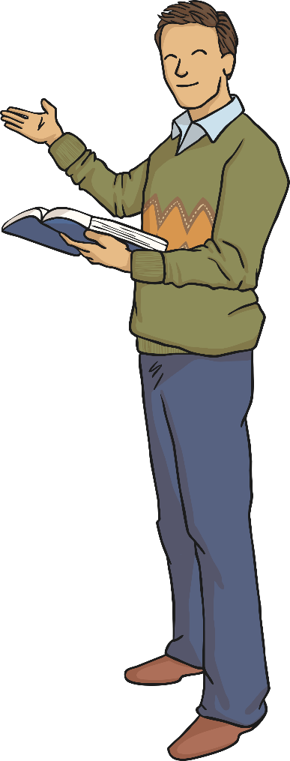
Clue
If a root word ends in
-ce the sh sound is normally spelt as c.
malice – malicious
grace – gracious
space – spacious
Exception:
anxious!

Slide 20
Clue
-cial is common after a vowel letter and -tial after a consonant letter, but there are some exceptions.
Exceptions include:
initial, financial, commercial, provincial

Slide 21
Clue
Use –ant, -ance or -ancy if there is a related word with an a or e sound in the right position (-ation endings are a clue).
Use -ent and -ence/-ency after soft c, soft g and qu sound, or if there is a related word with a clear e sound in the right position.
However – some words don’t match this pattern and have to be learned!

Slide 22
Clue
able endings are more common than ‘ible’ endings.
able is used with words that have an associated root word ending in ‘ation’. For example application – applicable.
If the -able ending is added to a word ending in -ce or -ge, the e after the c or g must be kept. Without the e, the c or g would make a hard sound before the -able ending. For example, without the e the word changeable would be changable.
The -able ending is usually but not always used if a complete root word can be heard before it, even if there is no related word ending in -ation.
For example dependable = depend (complete word) + able.

Slide 23
Clue
Not as common as able and ably; words.
For example, horrible – a complete root word can’t be heard. But sensible – sense (a complete root word can be heard!)
The -ible ending is common if a complete root word can’t be heard before it but it also sometimes occurs when a complete word can be heard.
For example, horrible – a complete root word can’t be heard. But sensible – sense (a complete root word can be heard!)
For example, horrible – a complete root word can’t be heard. But sensible – sense (a complete root word can be heard!)

Slide 24
Clue
The r is doubled if the -fer is still stressed when the ending is added.
The r is not doubled if the –fer is no longer stressed.

Slide 25
Clue
Hyphens can be used to join a prefix to a root word, especially if the prefix ends in a vowel letter and the root word also begins with one.

Slide 26
Clue
The i before e except after c’ rule applies to words where the sound spelt by ei is ee.
Exceptions: protein, caffeine, seize (and either and neither if pronounced with an initial i sound).

Slide 27
Clue
ough is one of the trickiest spellings in English – it can be used to spell a number of different sounds.
Try to remember it by finding a memorable way of saying the letters in the pattern out loud!

Slide 28
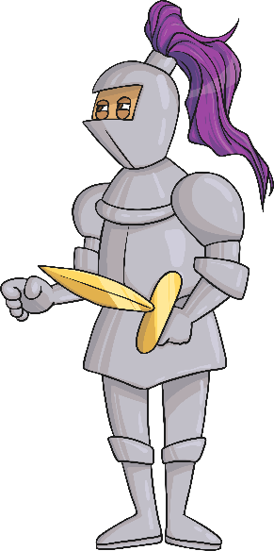
Clue
Slient letters are letters whose presence cannot be predicted by the pronounciation of a word.
Some letters which used to be sounded in the past are not sounded any longer, but saying them out loud can help you remember how to spell them.
The k and gh in knight used to be prounounced.
knight

Slide 29
Clue
In the list of words given, nouns end -ce and verbs end -se.
Advice and advise provide a useful clue as the word advise (verb) is pronounced with a z sound, which could not be spelt c.

